Slide 1
DNN for Concrete Strength prediction

Slide 2
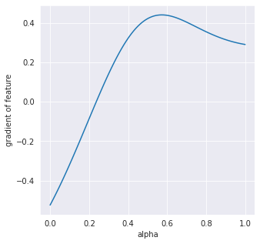
Finding the Optimal Composition
Seeking optimal predicted concrete strength vs. cost based on trained model
From the integrated gradient approach, we calculated overall gradient to determine the importance of features of the dataset
Calculating the individual gradient (partial derivative) and searching for the highest slope
Optimal composition of concrete mixture
arXiv:1703.01365

Slide 3
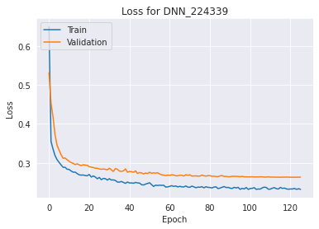
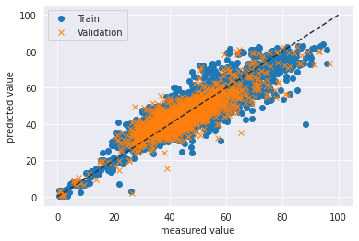
DNN
Batch Size: 128
# of Layers: 1
# of Neurons: 32
cv_r2: 0.7345
cv_mse: 35.89
cv_rmse: 5.99
Train_r2: 0.7767
train_mse: 30.54
train_rmse: 5.52

Slide 4
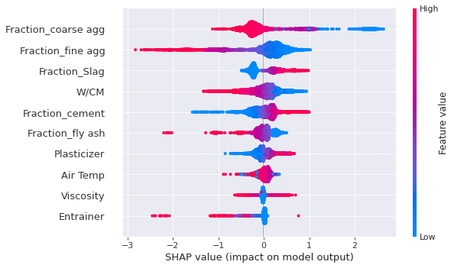
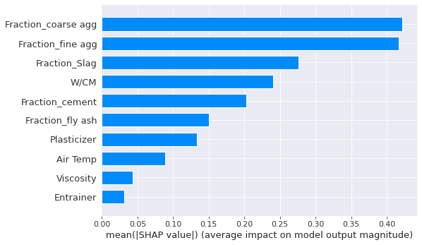
Shap Summary Plot

Slide 5
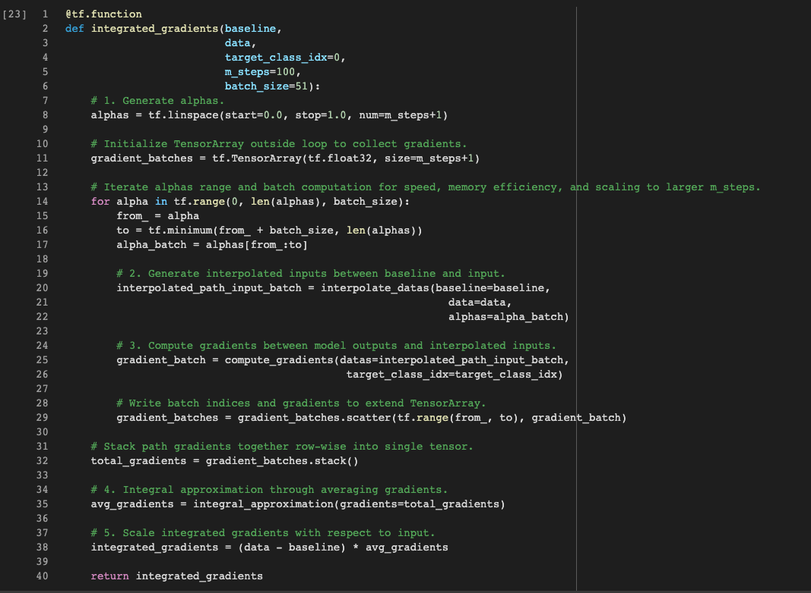

Slide 6
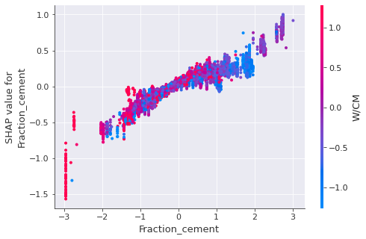
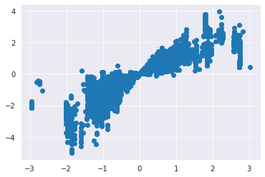
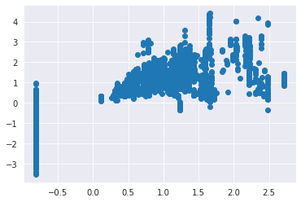
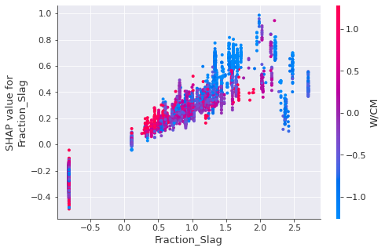

Slide 7
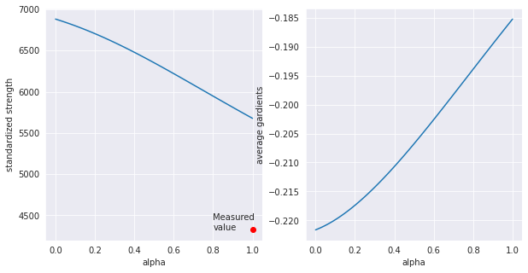
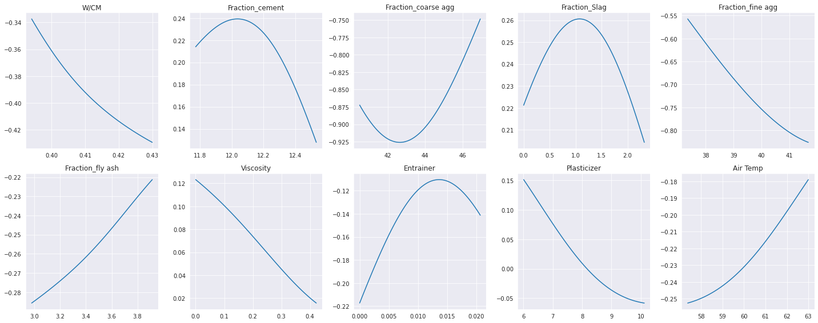
Gradients
Data index: 168

Slide 8
Current Issues
Replicating the result from SHAP library (have to figure out how they calculate the baseline)
Baseline selection
Determine the path for the gradient
Tuning the activation function and the model complexity

Slide 9
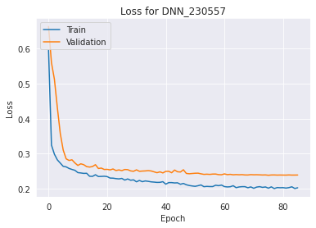
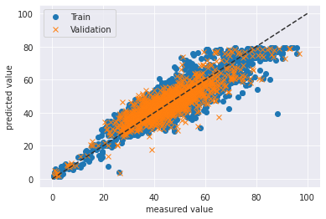
DNN
Batch Size: 128
# of Layers: 2
# of Neurons: 32, 32
cv_r2: 0.7591
cv_mse: 32.58
cv_rmse: 5.71
Train_r2: 0.8096
train_mse: 26.04
train_rmse: 5.10

Slide 10
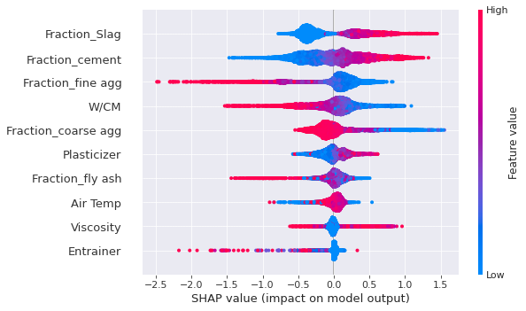
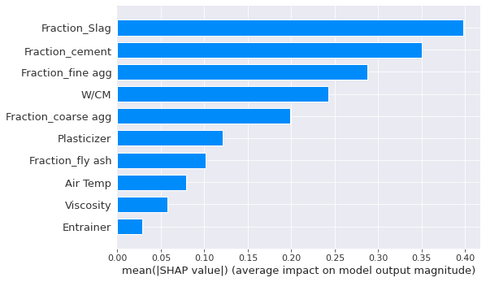
Shap Summary Plot

Slide 11
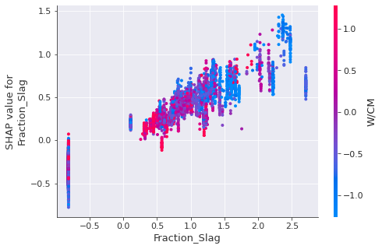
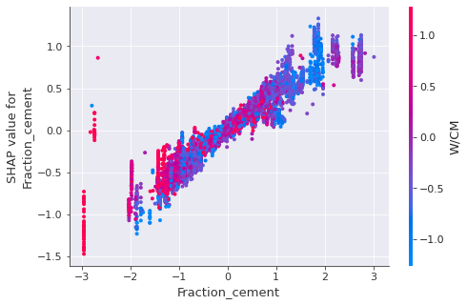

Slide 12
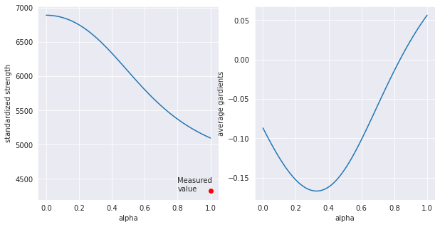
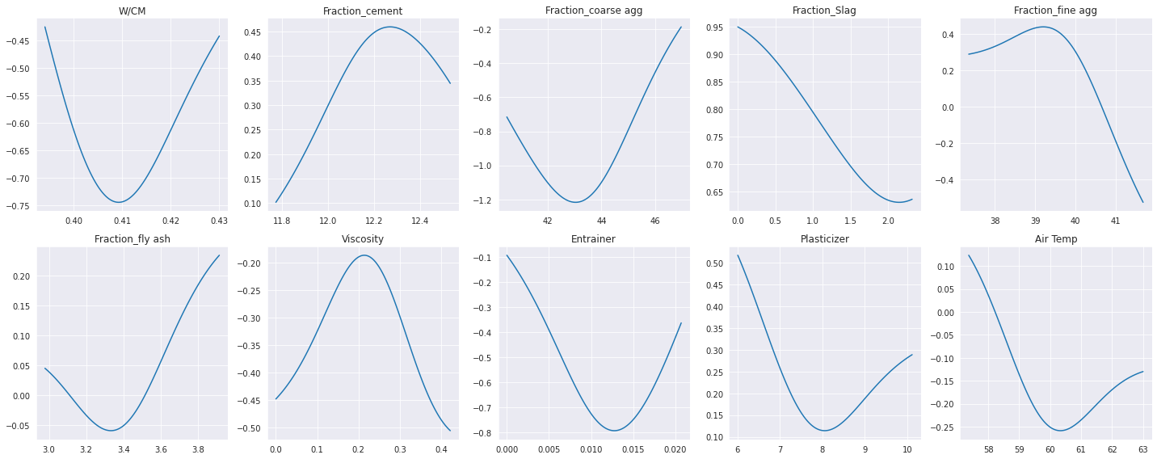
Gradients
Data index: 7250

Slide 13
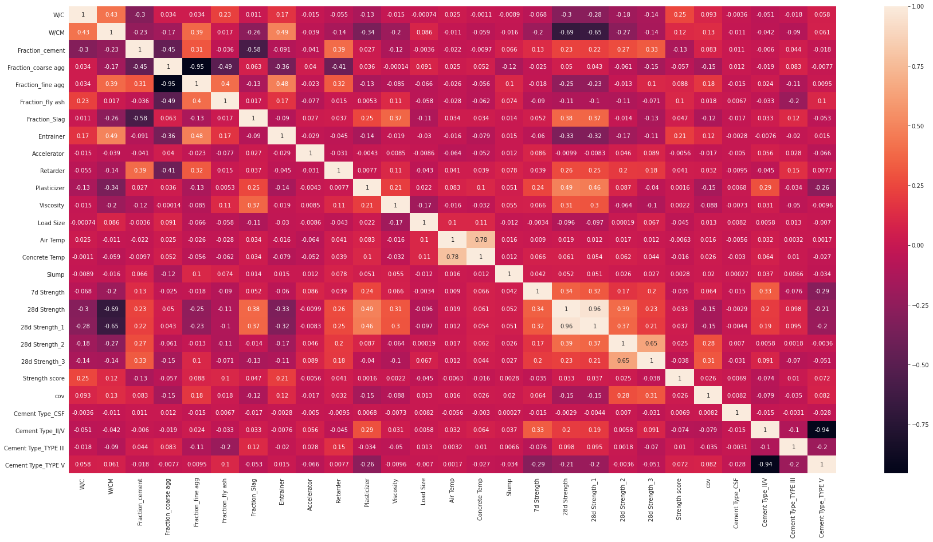

Slide 14
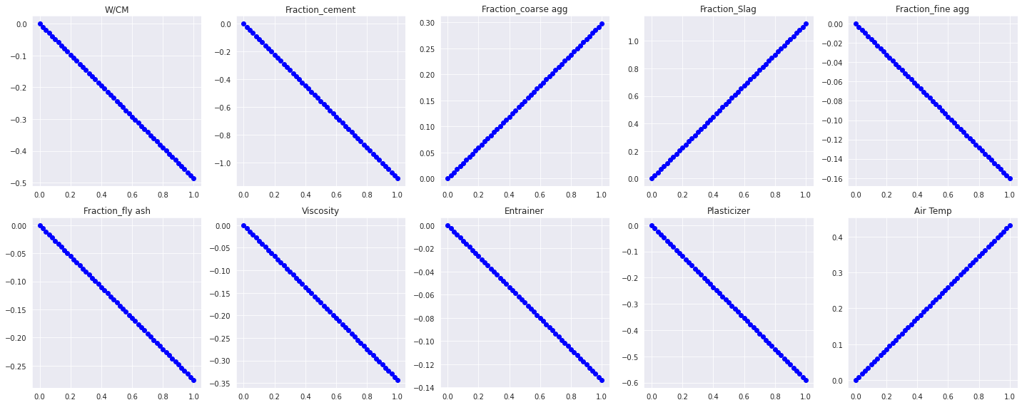
Interpolated Data

Slide 15
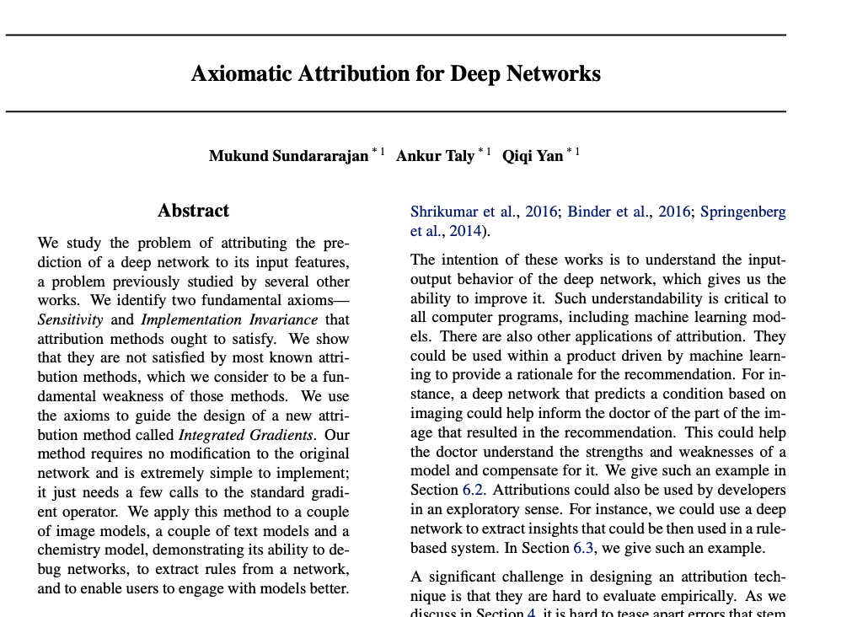
arXiv:1703.01365

Slide 16
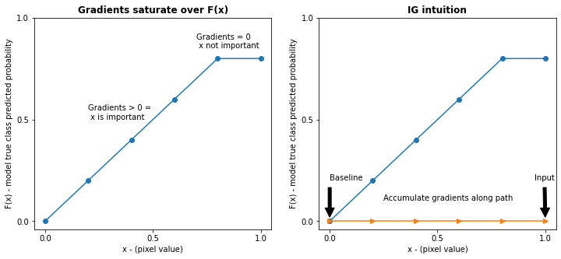
Integrated Gradients
Integrate gradients along with alpha

